Slide 1
BINARY SEARCH TREE
DCIT25- DATA STRUCTURES & ALGORITHMS

Slide 2
BINARY Search Tree
OUTLINE
Trees
Binary Tree
Types of Binary Tree
Size, Degree & Depth of Binary Tree
Level and height of a tree
Root, node and leaf of a tree
Notes:
In Slide Show mode, click the arrow to enter the PowerPoint Getting Started Center.

Slide 3
BINARY Search Tree
OBJECTIVES:
To familiarize with the different types of trees.
To determine the height and depth of a tree.
To know the functions of different data structure terminologies
Notes:
In Slide Show mode, click the arrow to enter the PowerPoint Getting Started Center.

Slide 4
TREE
A tree is a non-linear data structure. Compared to arrays, linked lists, stacks and queues which are linear data structures, a tree can be empty with no nodes or consist of only one node called the root, and zero or one or more sub-trees.
Tree is a non-linear data structure which organizes data in a hierarchical structure and this is a recursive definition. It is a connected graph without any circuits. If in a graph, there is one and only one path between every pair of vertices, then it is called a tree.

Slide 5
TREE
The important properties of tree data structure are:
There is one and only one path between every pair of vertices in a tree.
A tree with n vertices has exactly (n-1) edges.
A graph is a tree if and only if it is minimally connected.
Any connected graph with n vertices are (n-1) edges is a tree.

Slide 6
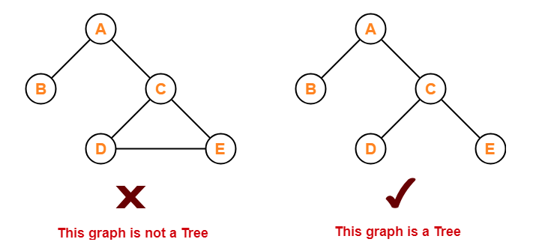
TREE

Slide 7
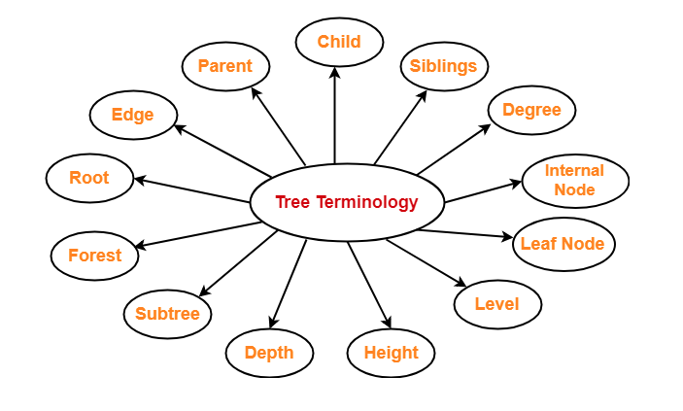
Tree Terminology
Important terms:

Slide 8
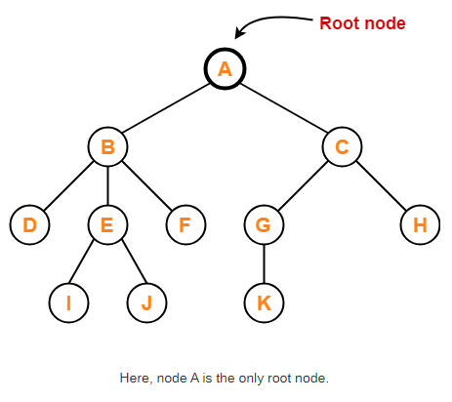
Root
The first node from where the tree originates is known as root node.
In a tree, there must be only one root node.
Tree data structure can never have multiple root nodes.
Example:

Slide 9
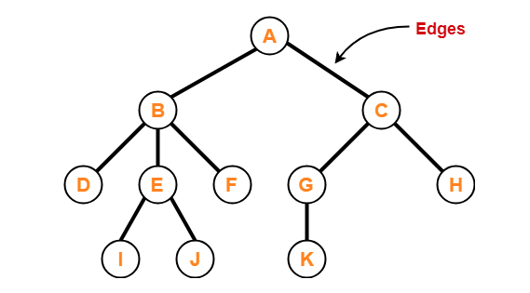
Edge
The connecting link between any two nodes is called edge.
In a tree with n number of nodes, there are exactly (n-1) number of edges.
Example:

Slide 10
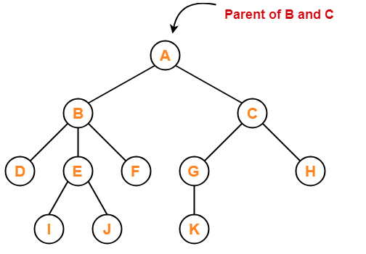
Parent
The node which has a branch from it to any other node is known as parent node.
In other words, it has one or more children.
In a tree, a parent node can have any number of child nodes.
Example:

Slide 11
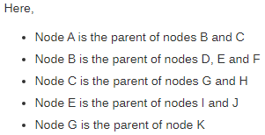
Parent
The node which has a branch from it to any other node is known as parent node.
In other words, it has one or more children.
In a tree, a parent node can have any number of child nodes.
Example:

Slide 12
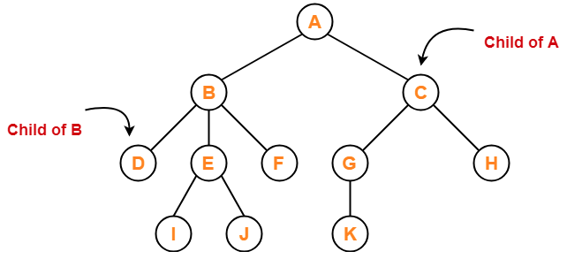
Child
The node which is a descendant of some node is called child node.
All the nodes except root node are child nodes.
Example:

Slide 13
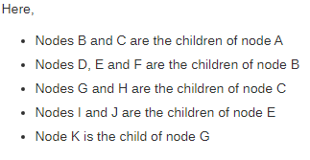
Child
The node which is a descendant of some node is called child node.
All the nodes except root node are child nodes.
Example:

Slide 14
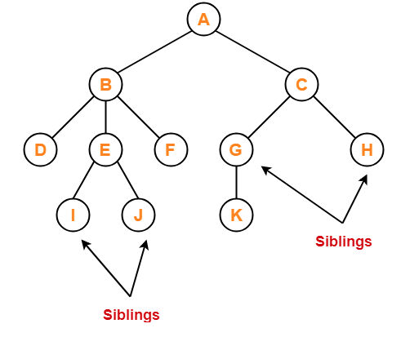
Siblings
Nodes which belong to the same parent are siblings.
In other words, the nodes have the same parent.
Example:

Slide 15
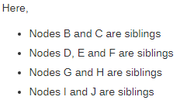
Siblings
Nodes which belong to the same parent are siblings.
In other words, the nodes have the same parent.
Example:

Slide 16
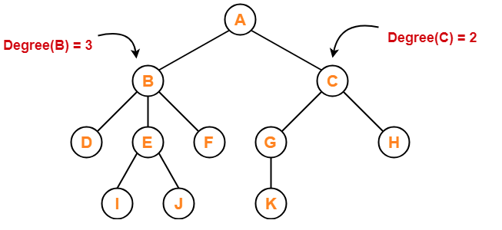
Degree
Degree of a node is the total number of children of that node.
Degree of a tree is the highest degree of a node among all the nodes in the tree.
Example:

Slide 17
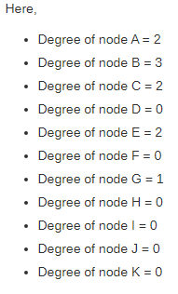
Degree
Degree of a node is the total number of children of that node.
Degree of a tree is the highest degree of a node among all the nodes in the tree.
Example:

Slide 18
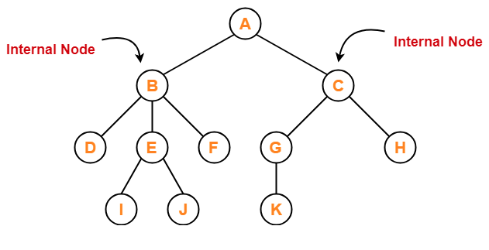
Internal Node
The node which has at least one child is called as an internal node.
Internal nodes are also known as non-terminal codes.
Every non-leaf node is an internal node.
Example:

Slide 19
Internal Node
The node which has at least one child is called as an internal node.
Internal nodes are also known as non-terminal codes.
Every non-leaf node is an internal node.
Example:

Slide 20
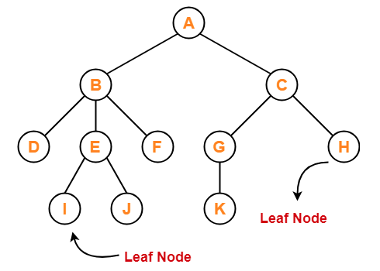
Leaf Node
The node which does not have any child is called a leaf node.
Leaf nodes are also called external nodes or terminal nodes.
Example:

Slide 21

Leaf Node
The node which does not have any child is called a leaf node.
Leaf nodes are also called external nodes or terminal nodes.
Example:

Slide 22
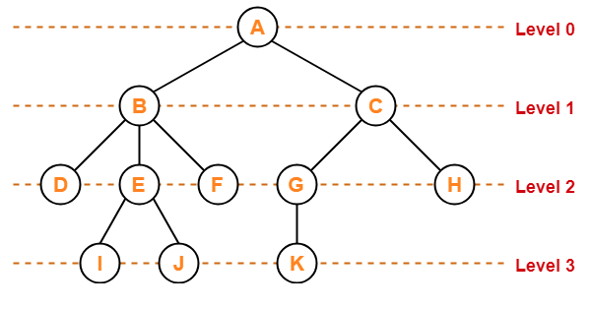
Level
In a tree, each step from top to bottom is called level of a tree.
The level count starts with 0 and there is increments of 1 at each level or step.
Example:

Slide 23
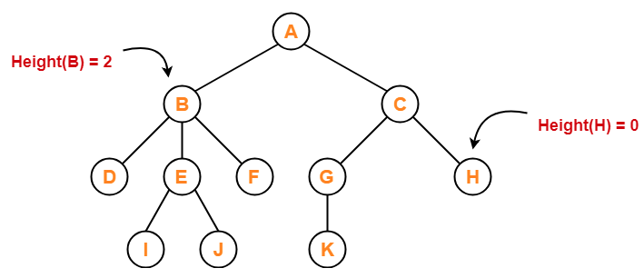
Height of a node
Total number of edges that lies on the longest path from any leaf node to a particular node is called a height of that node. Height of all leaf nodes = 0.
Height of a tree is equal to the height of a root node.
Example:

Slide 24
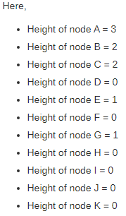
Height of a node
Total number of edges that lies on the longest path from any leaf node to a particular node is called a height of that node. Height of all leaf nodes = 0.
Height of a tree is equal to the height of a root node.
Example:

Slide 25
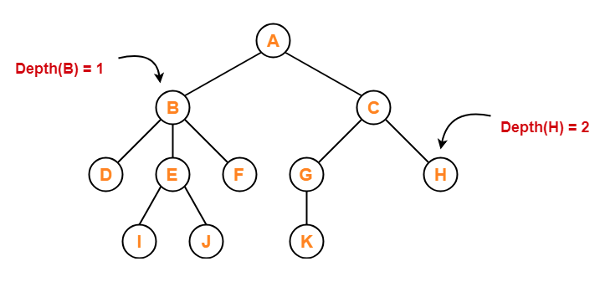
Depth of a node
Total number of edges from root node to a particular node is known as depth of that node.
Depth of a tree is the total number of edges from root node to a leaf node in the longest path. Depth of all root node = 0.
The depth of a tree is equal to the height of a root node.
The terms “level” and “depth” are used interchangeably.
Example:

Slide 26
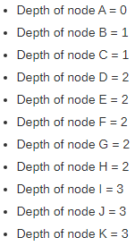
Depth of a node
Total number of edges from root node to a particular node is known as depth of that node.
Depth of a tree is the total number of edges from root node to a leaf node in the longest path. Depth of all root node = 0.
The depth of a tree is equal to the height of a root node.
The terms “level” and “depth” are used interchangeably.
Example:

Slide 27
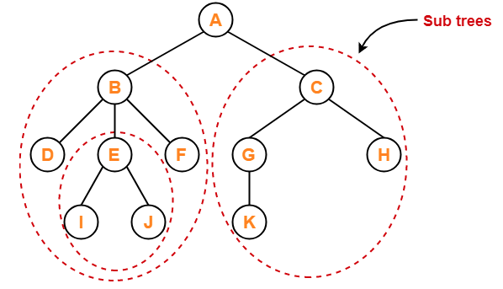
Subtree
In a tree, each child from a node forms a subtree recursively.
Every child node forms a subtree on its parent node.
Example:

Slide 28
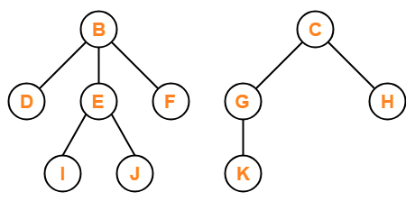
Forest
A forest is a set of disjoint trees.
Example:

Slide 29
TYPES of Binary Tree
Full
Complete
Skewed
Notes:
In Slide Show mode, click the arrow to enter the PowerPoint Getting Started Center.

Slide 30
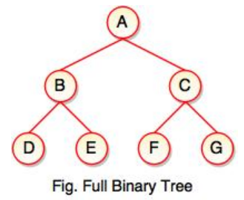
Full
Full binary tree is composed of 0 or 2 children in every node.
It can also be called as such if all nodes except leaf nodes have two children.
Example:
Number of leaf nodes is the number of internal nodes plus 1
L = I + 1
L = number of leaf nodes
I = number of internal nodes

Slide 31
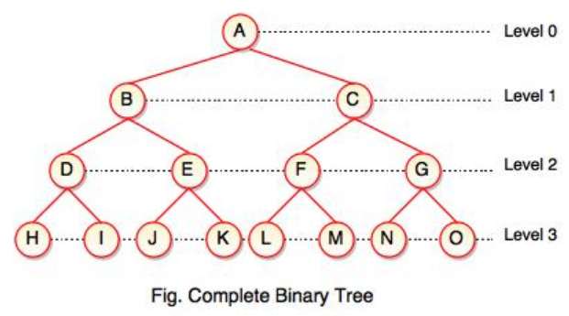
Complete
A complete binary tree is characterized by having all the levels completely filled except (possibly) for the last level.
Last level has all keys as left as possible.
Example:

Slide 32
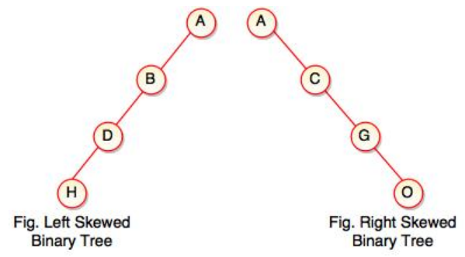
Skewed
If the left child node or right child node dominates the tree, it is then called skewed binary tree.
All nodes except one have only one child node while the remaining node has no child.
Left skewed tree is characterized by a left child in most of the nodes with no corresponding right child.
Right skewed tree is the opposite of the left.
Example:

Slide 33
References:
John Bullinaria ; March 2019 ; Data Structures and Algorithms ; Birmingham, UK;
https://www.gatevidyalay.com/tag/trees-in-data-structure-ppt/
https://www.tutorialspoint.com/data_structures_algorithms/dsa_quick_guide.htm
https://www.tutorialride.com/data-structures/types-of-binary-tree.htm

Slide 34

END
Thank You ! GOD BlESS.
Keep Safe Everyone!
Notes:
In Slide Show mode, click the arrow to enter the PowerPoint Getting Started Center.

